Slide 1




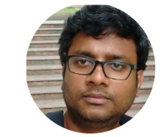

- The perfect combo
Raja Kumaravel
Technical Architect
https://www.linkedin.com/in/rajakumaravel

Slide 2

Agenda
Introduction about Blockchain
Bitcoin Mining
Smart Contract Demo using Solidity
Decentralized Application Demo
Fundamental of AI,ML,DL
Blockchain & AI – The perfect combo
Q&A
Twitter @GABChennai

Slide 3
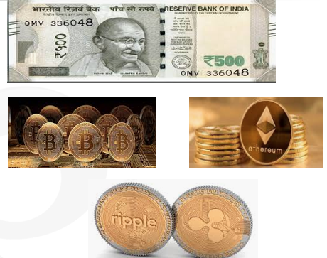
Brief evolution of (Crypto)currency
During the 2008 global financial crisis, Federal Reserve
Satoshi Nakamoto

Slide 4
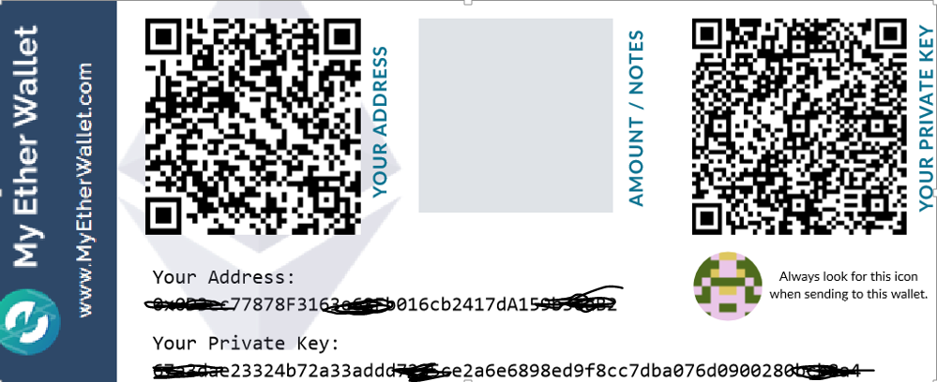
Ether’s Hot Wallet
hot wallets are connected to the Internet, while cold wallets are kept offline

Slide 5
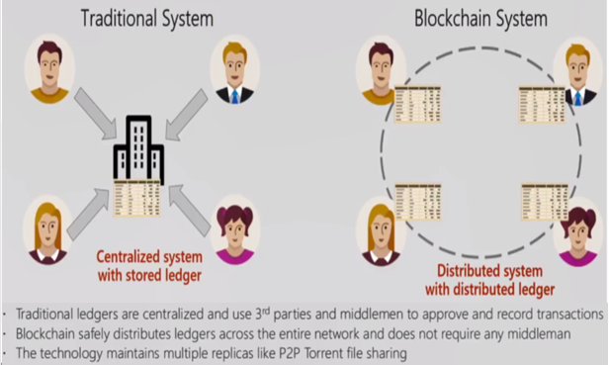
Traditional System vs Blockchain System
Let’s take the Employee portal, Recruitment Team, HR etc., in an Organization as an example

Slide 6
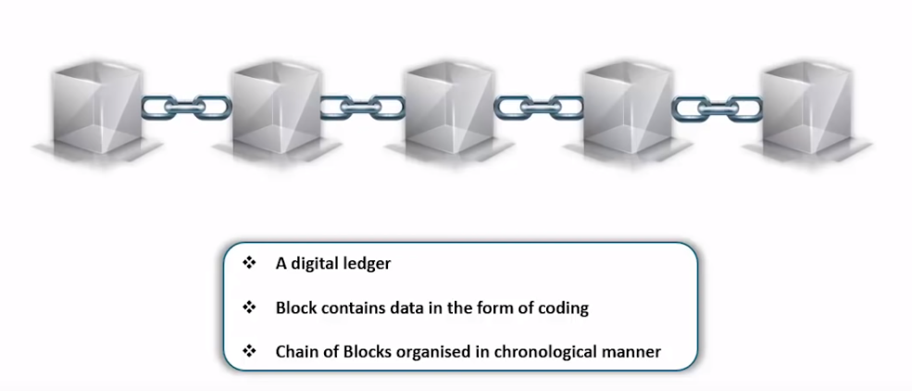
What is Blockchain?
It is a time-stamped series of immutable record of data that is managed by cluster of computers not owned by any single entity.

Slide 7
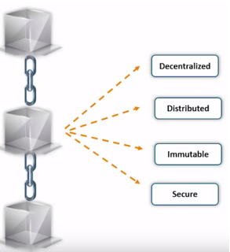
Features of Blockchain
Blockchain is a very powerful technology. This has potential to change the future. Wherever trust is a major concern, this technology can play a significant role.

Slide 8
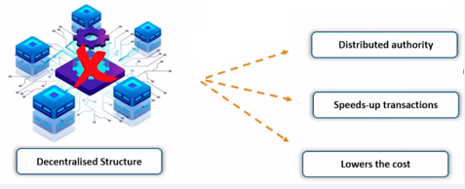
Why is Decentralised
The decentralized nature of blockchain technology means that it doesn't rely on a central point of control.

Slide 9
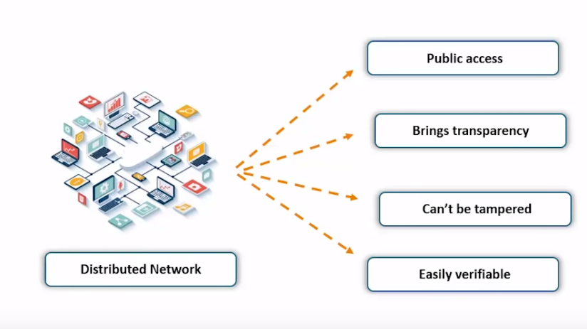
What is Distributed

Slide 10
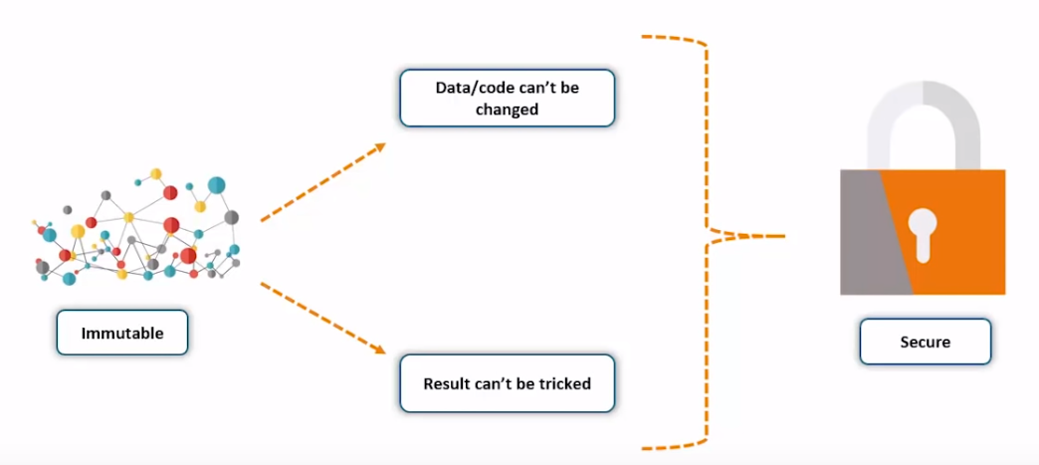
Immutable and Secure

Slide 11
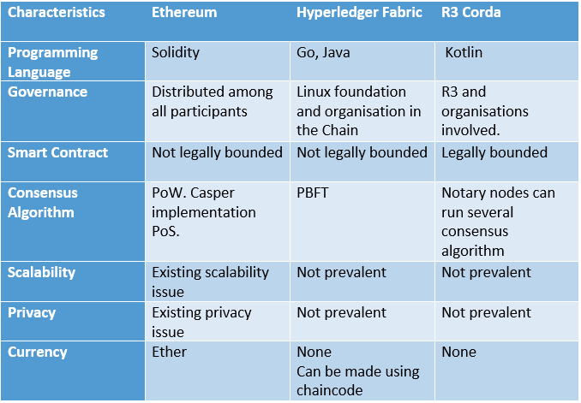
Distributed Ledger Technologies(DLTs)
The programming language used to create applications and contracts for the DLTs.

Slide 12
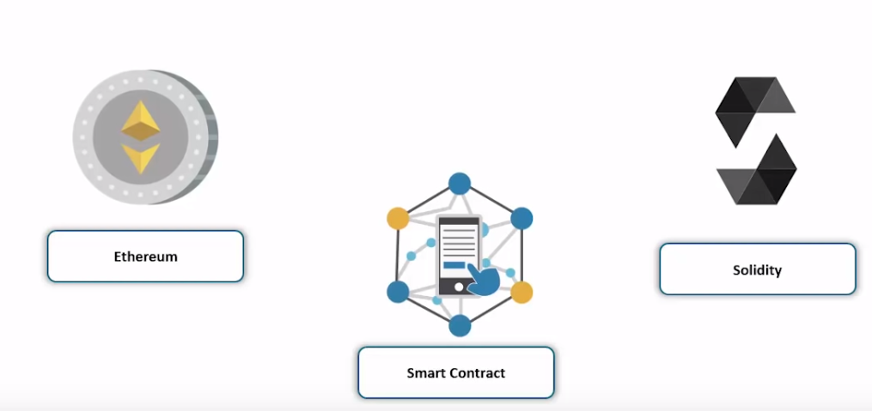
Blockchain Implementation
Solidity is an object-oriented, high-level language for implementing smart contracts.
It is designed to target the Ethereum Virtual Machine (EVM)

Slide 13
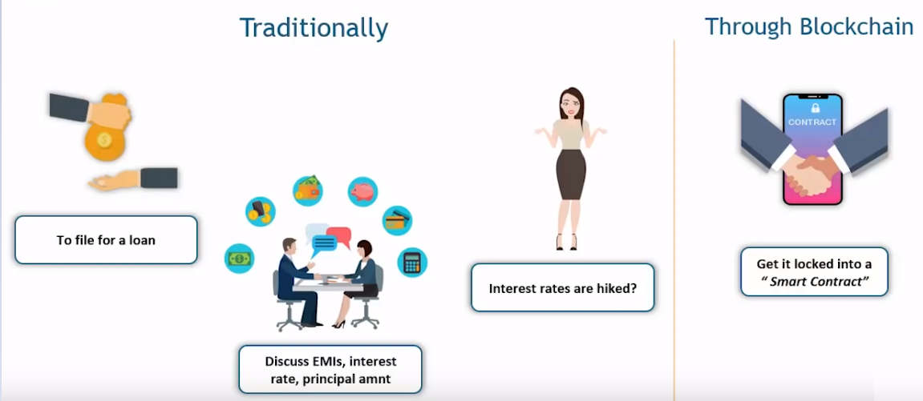
Financial Transaction in today’s world
Smart Contracts in blockchain finance can help build a transparent and trusted system across participants in the network.

Slide 14
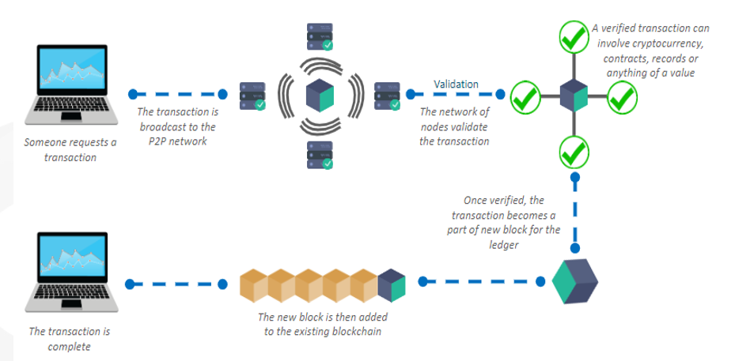
Blockchain Flow
A node starts a transaction by first creating and then digitally signing it with its private key.
Usually, more than one node is required to verify the transaction.
Once the transaction is validated, it is included in a block, which is then transmitted onto the network. At this point, the transaction is considered confirmed.
Usually, six confirmations in the a network are required to consider the transaction final.

Slide 15
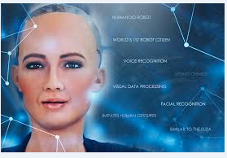
Artificial Intelligence
The overall research goal of artificial intelligence is to create technology that allows computers and machines to function in an intelligent manner.
Sophia – well known, acknowledged product of AI. She holds citizenship of Saudi Arabia

Slide 16
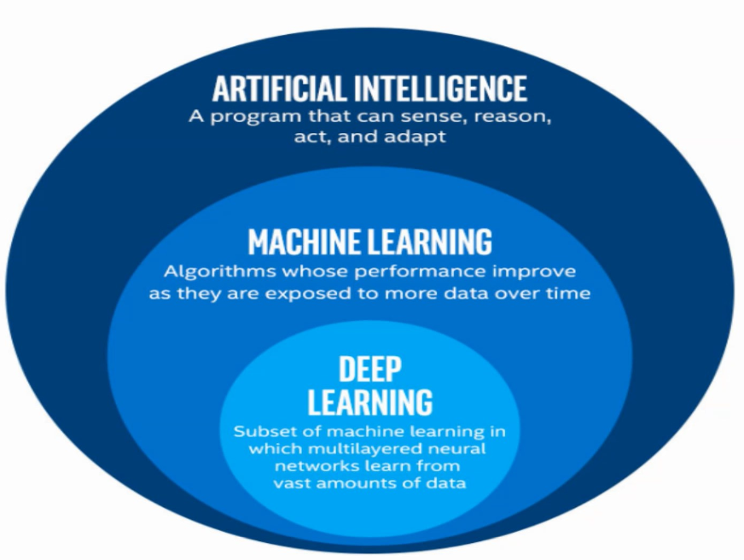
AL, ML & DL
ML & DL are two methodologies
ML = 5 yrs old baby and DL = 10 yrs old kid
ML follows probability and linear algebra and it needs 8 GB RAM.

Slide 17
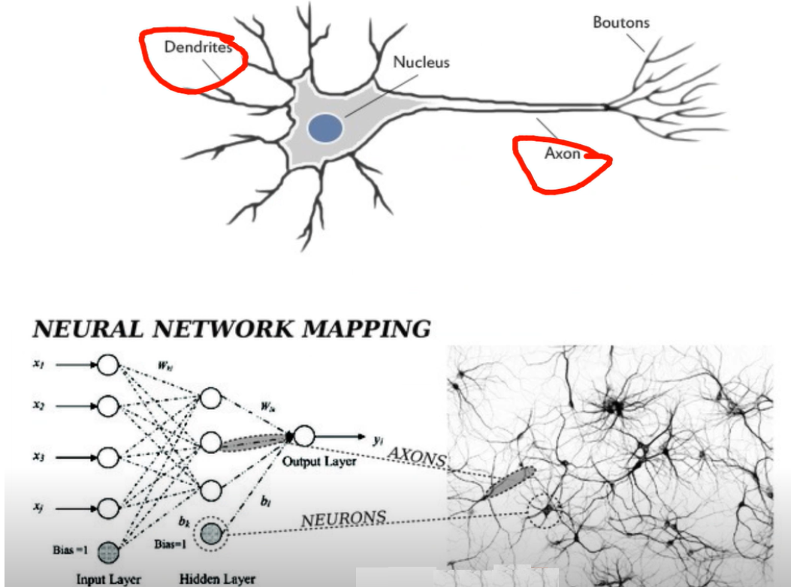
Deep Learning
DL needs GPU computation power to run the algorithm.
DL is similar to human brain concept

Slide 18
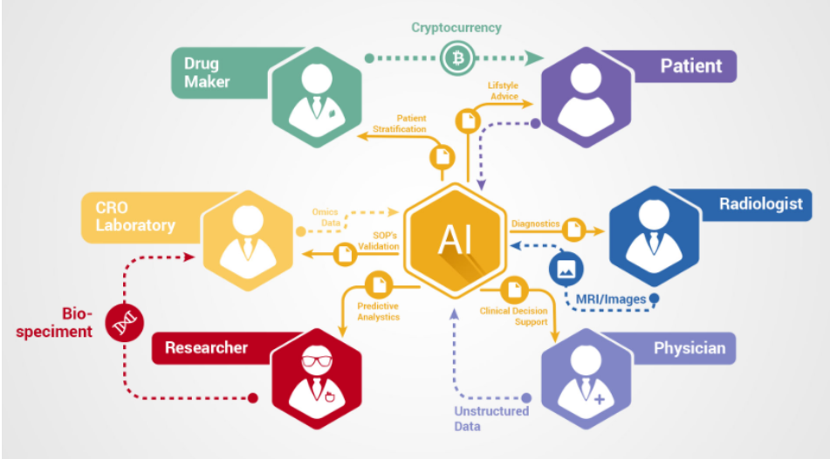
Blockchain & AI – The perfect combo
AI, blockchain and Machine Learning can be highly useful for selective information sharing without revealing the identity of the person. The selective sharing of data is possible through the use of protocols such as zero-knowledge proofs. It will be very convenient for the healthcare industry where blockchains could help us store information in such a way that doctors can see a patient’s entire medical history, but researchers see only statistical data instead of any personal information.

Slide 19
Demo 1 – Bitcoin Mining
Demo 1 – Bitcoin Mining

Slide 20
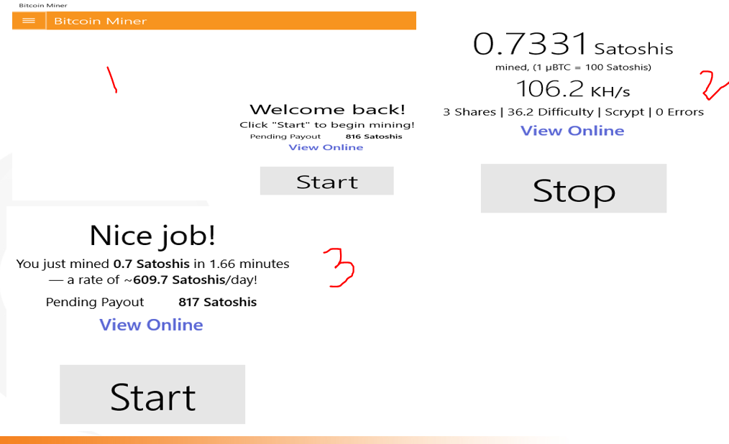
Bitcoin Miner

Slide 21
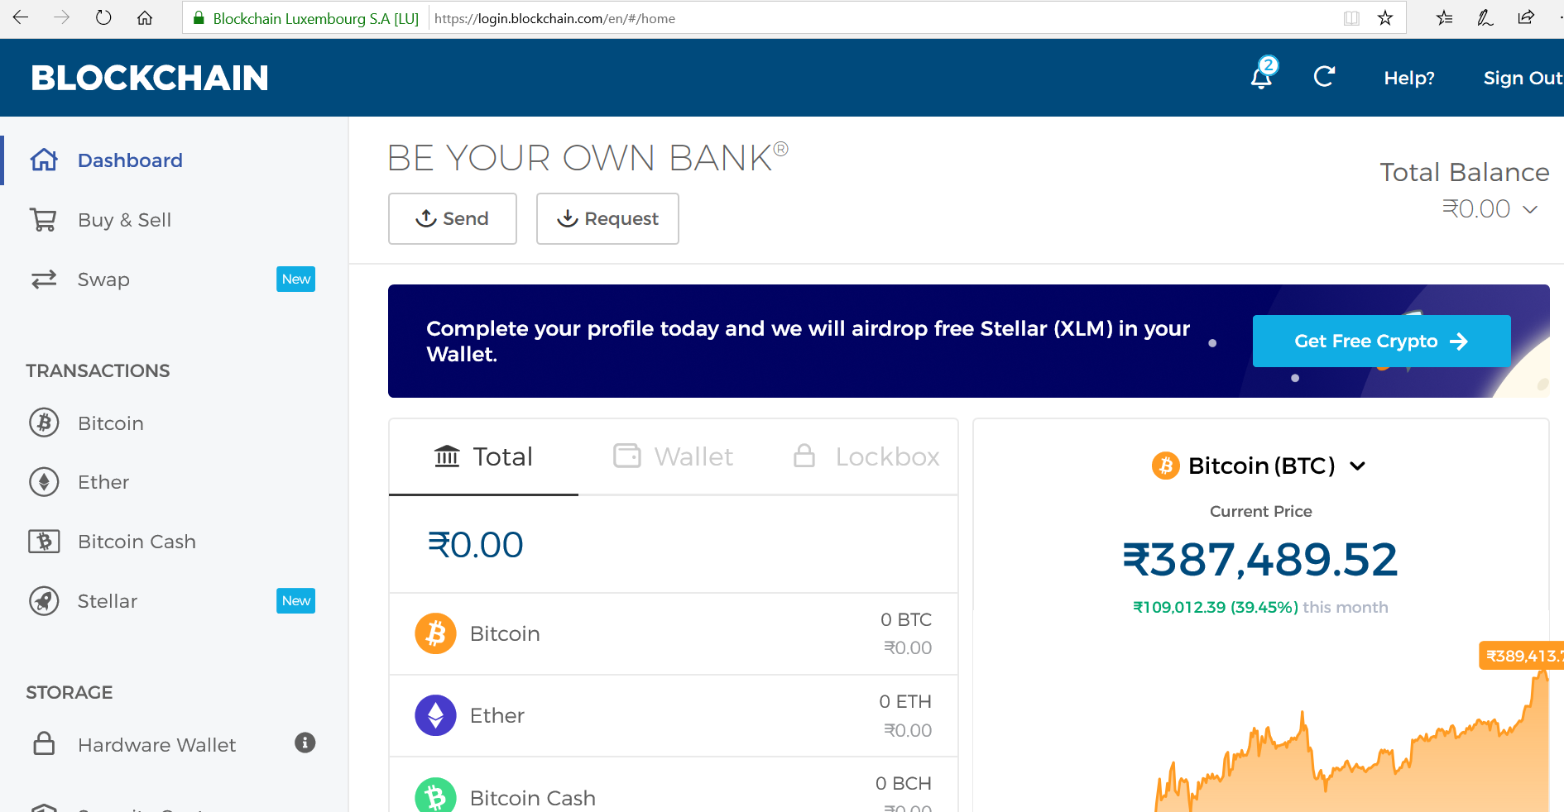
Blockchain wallet

Slide 22
Demo 2 – Smart Contract in Remix Compiler
Demo 2 – Smart Contract in Remix Compiler

Slide 23
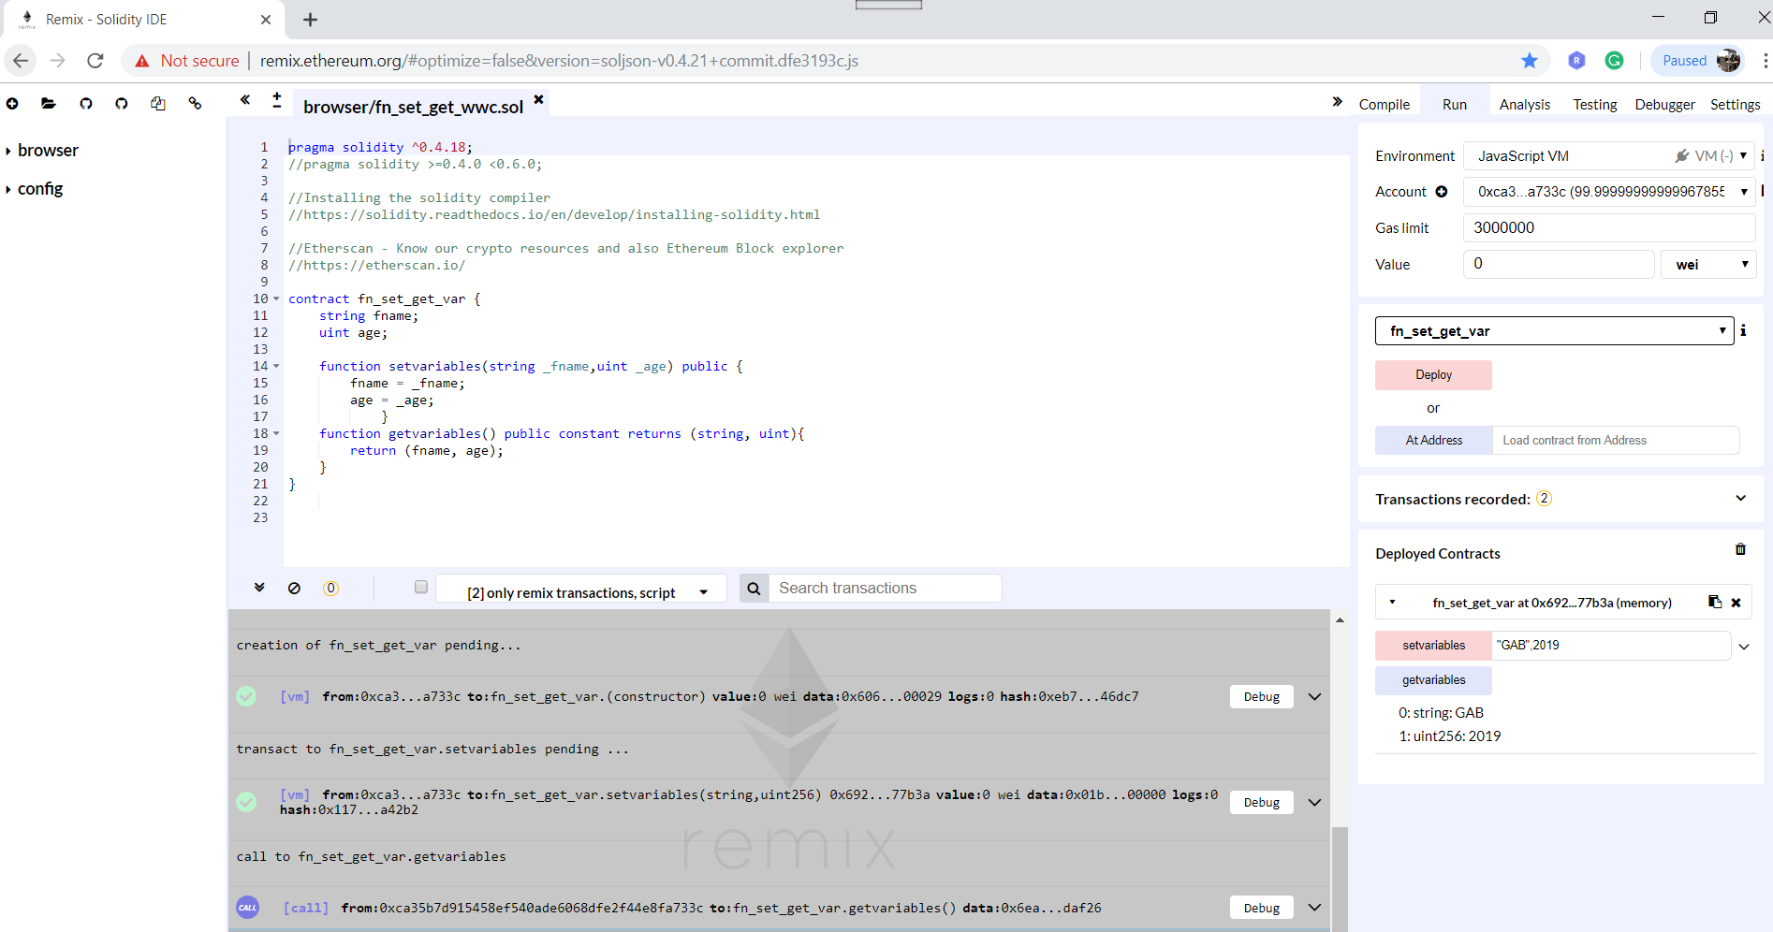
Smart Contract in Remix Compiler

Slide 24
Demo 3 – DAPP
Demo 3 – DAPP

Slide 25
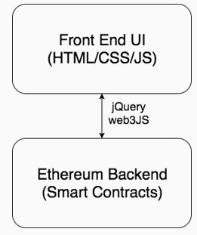
DAPP(Decentralized Application) Architecture
Blockchain app architecture also has frontend and backend
-front end is also written in HTML/CSS/JS
-backend is written in Solidity and deployed to Ethereum

Slide 26
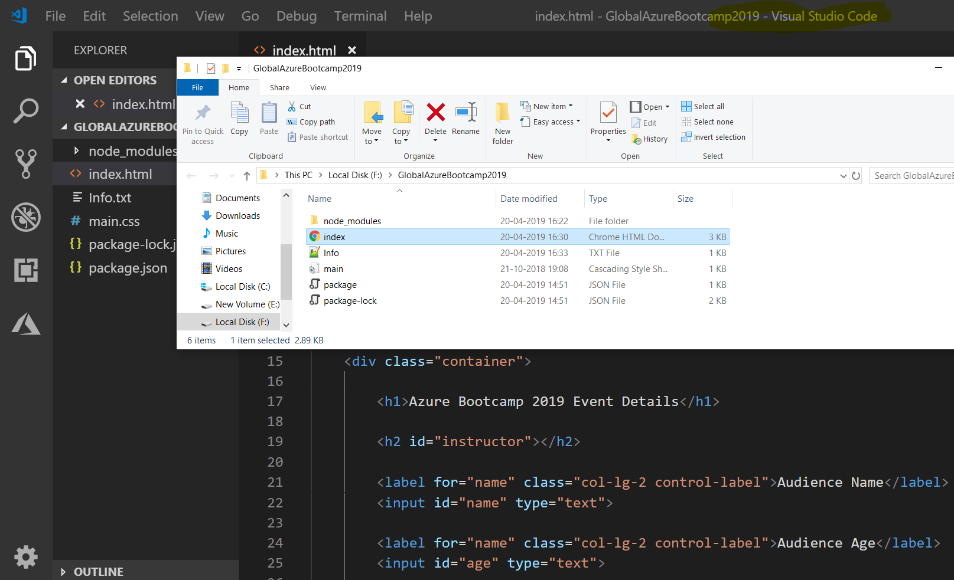
DAPP – Folder Structure
Dsgsd

Slide 27
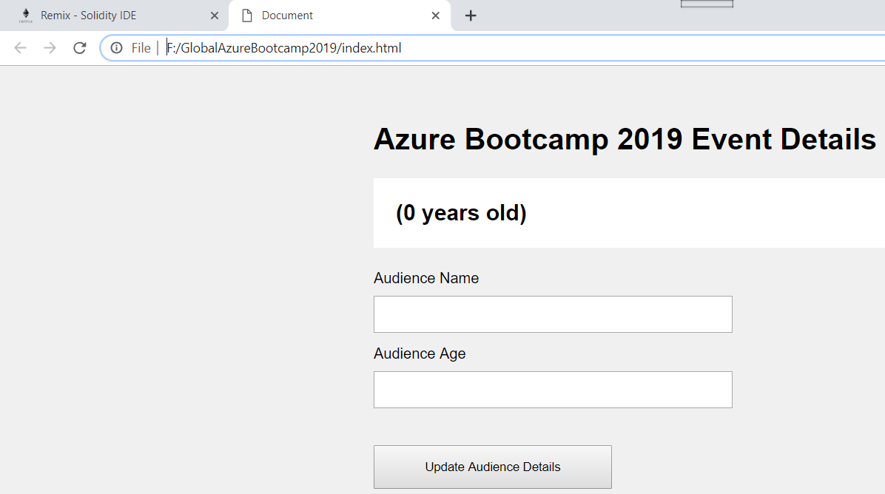
DAPP - Demo

Slide 28
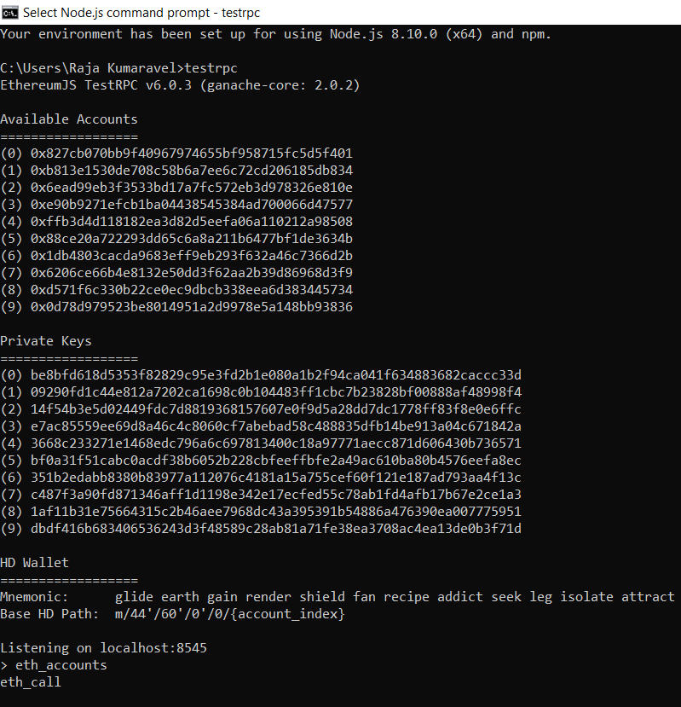
Testrpc (Ganache)
Ganache, previously Testrpc, is a virtual blockchain which sets up 10 default Etheruem addresses, complete with private keys and all.

Slide 29
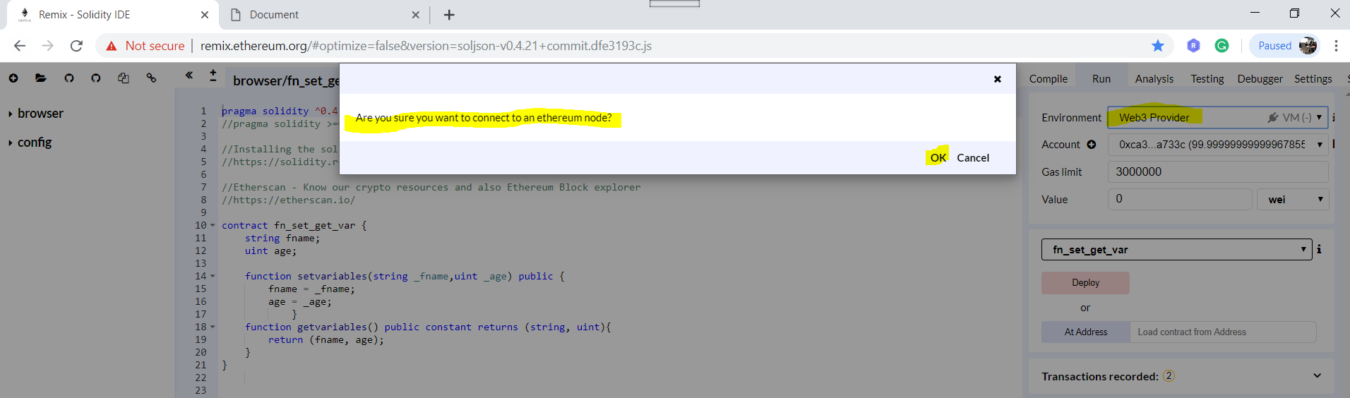
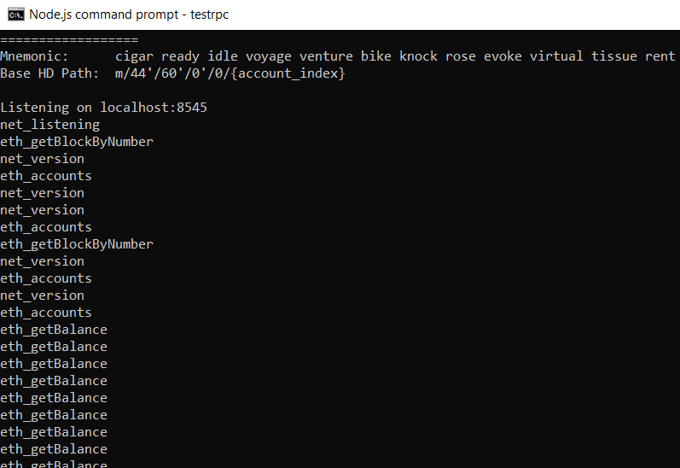
Setup Web3 Provider in Remix Compiler

Slide 30
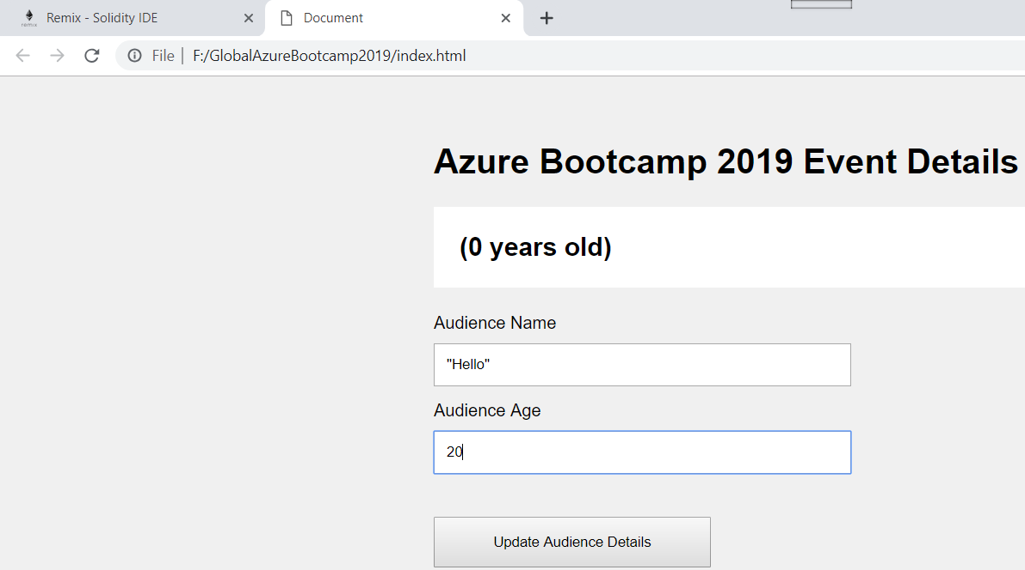
DAPP – Front end Screen and Remix Compiler for result

Slide 31
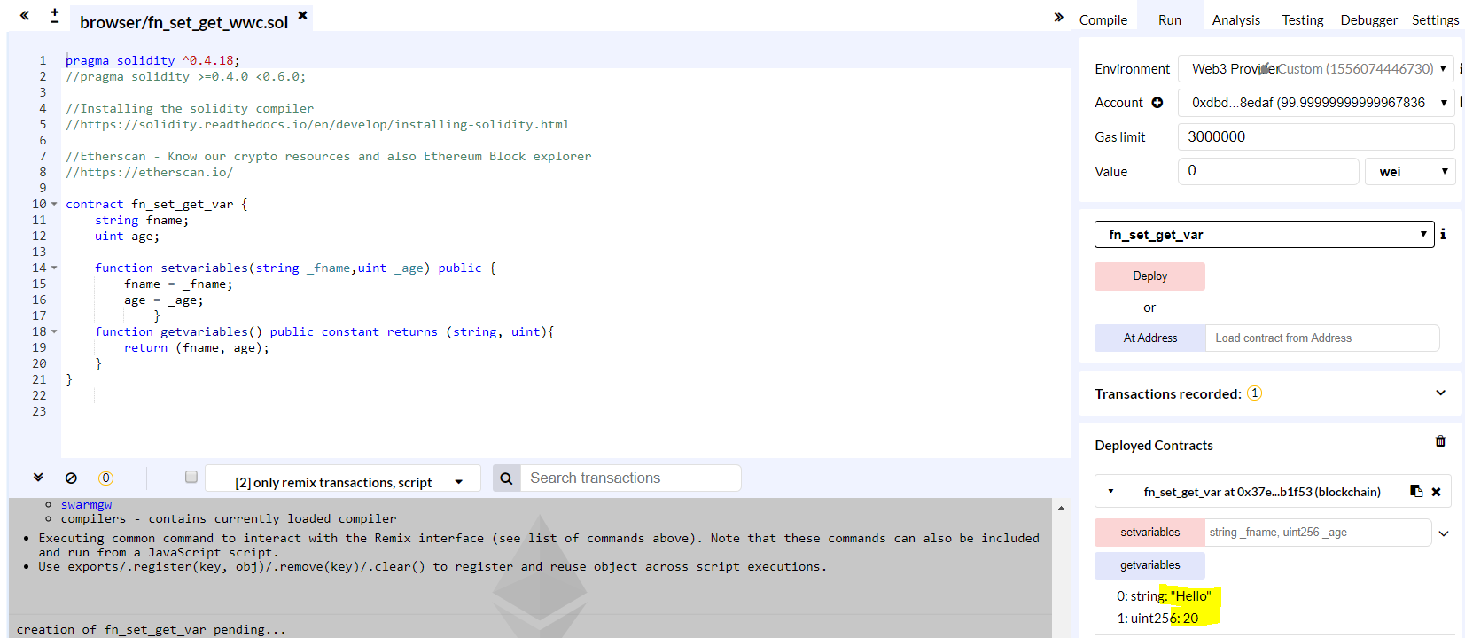
DAPP – Front end Screen and Remix Compiler for result

Slide 32
Q&A
Q&A

Slide 33
Thank you.
Raja Kumaravel
Technical Architect,
Encore
connectraja@gmail.com

